Slide 1
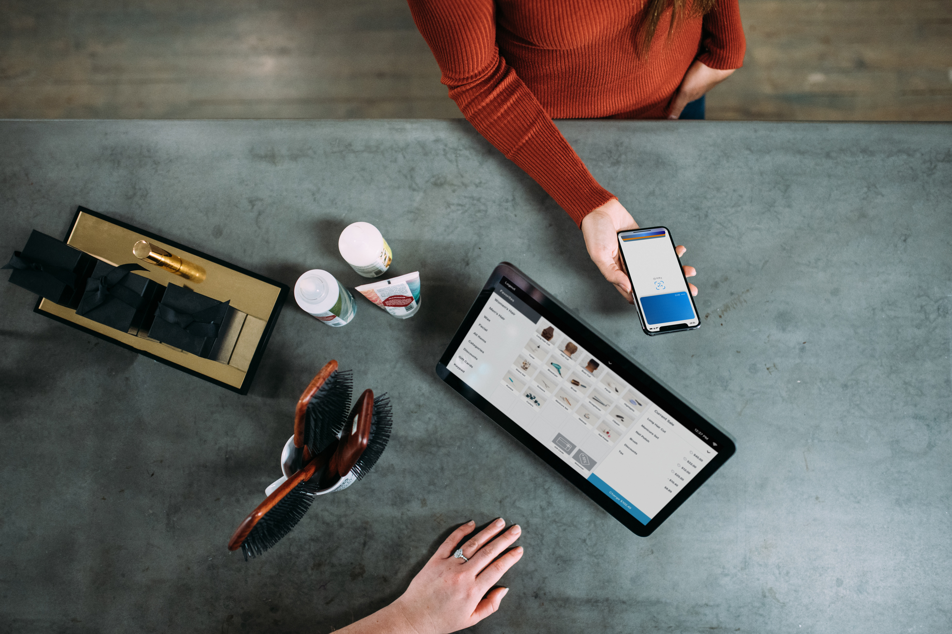
THE SHOPPING APP

Slide 2

Team Members
Sai Kumar
Prajakta
Shaina
Naveen Kumar
Lily Liu
Pratesh

Slide 3

What is E-Commerce
Commonly known as Electronic Marketing.
“It consist of buying and selling goods and services
over an electronic systems Such as the internet and
other computer networks.”

Slide 4

Our System
Our System is an e-commerce website from where people can buy products online.
Admin monitors the activity of the users and checks the transactions.

Slide 5

Features:
Login
Category List
Product List
Product Price
Shopping Cart

Slide 6

Languages:
Tools:
HTML 5
CSS 3
MySQL
Angular
SQL server

Slide 7

ADVANTAGES OF E-COMMERCE
Faster buying/selling procedure, as well as easy to
find products.
Buying/selling 24/7.
More reach to customers, there is no theoretical geographic limitations.
Low operational costs and better quality of services.
No need of physical company set-ups.
Easy to start and manage a business.

Slide 8
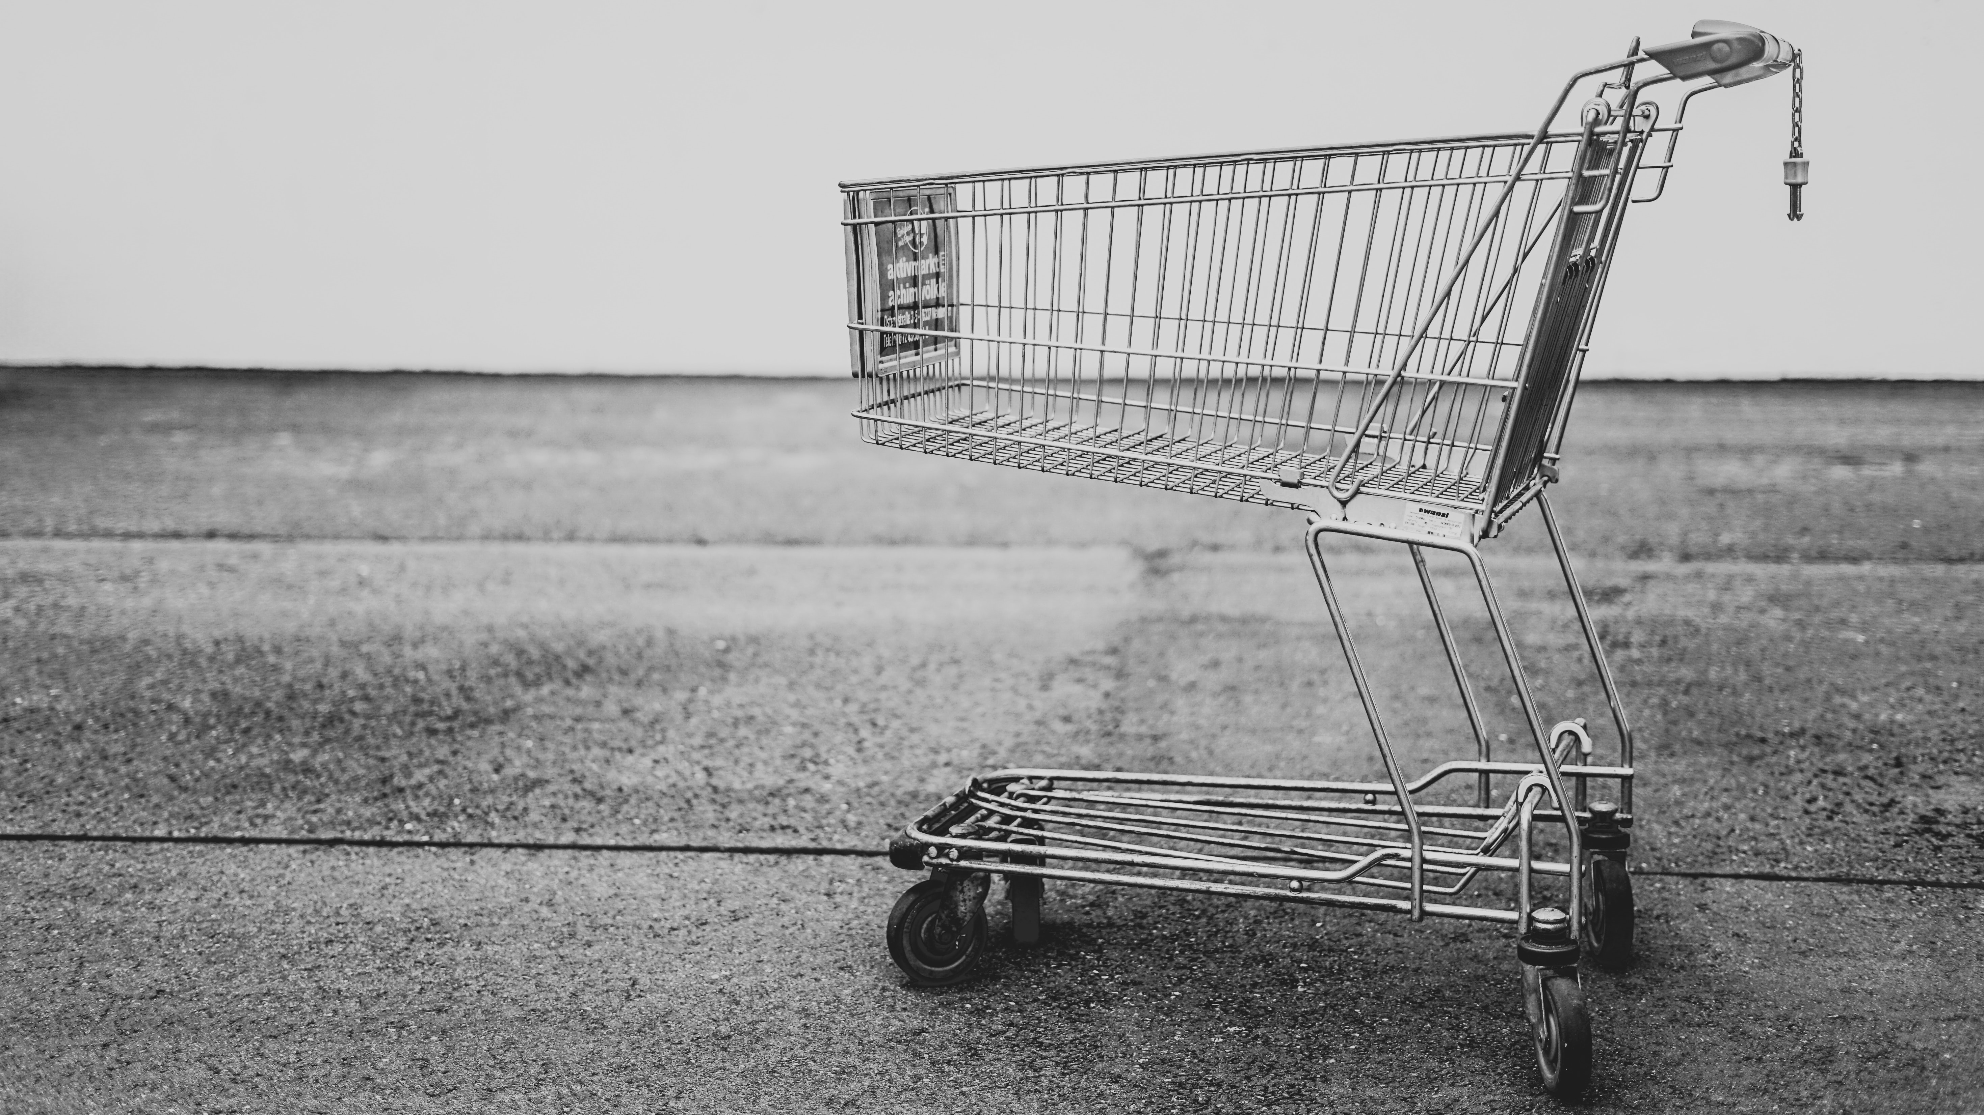
DISADVANTAGES OF E-COMMERCE
Unable to examine products personally
Not everyone is connected to the Internet
There is the possibility of credit card number theft
Mechanical failures can cause unpredictable
effects on the total processes.

Slide 9

What’s New
Checkout
Designing of Background
Font Size
Payment Gateway

Slide 10

GUI
(Graphical User Interface)

Slide 11

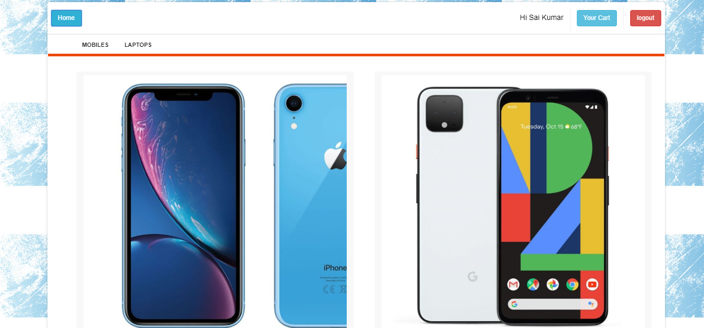
Homepage

Slide 12
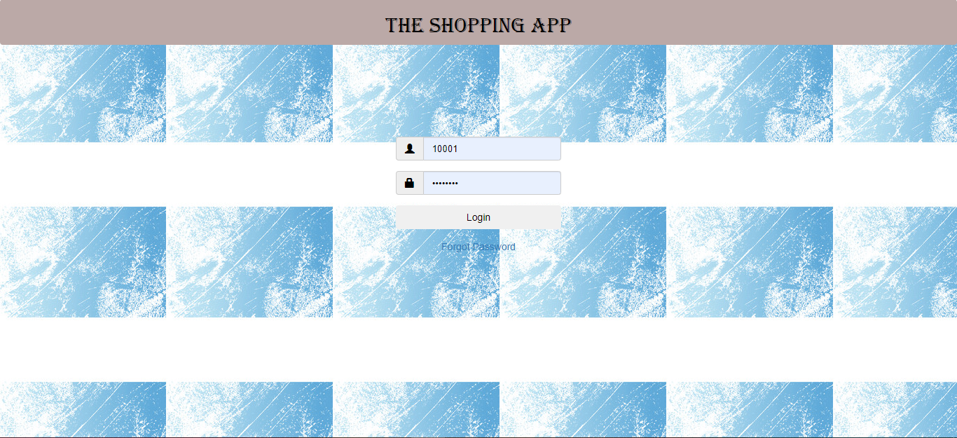
Login Page

Slide 13
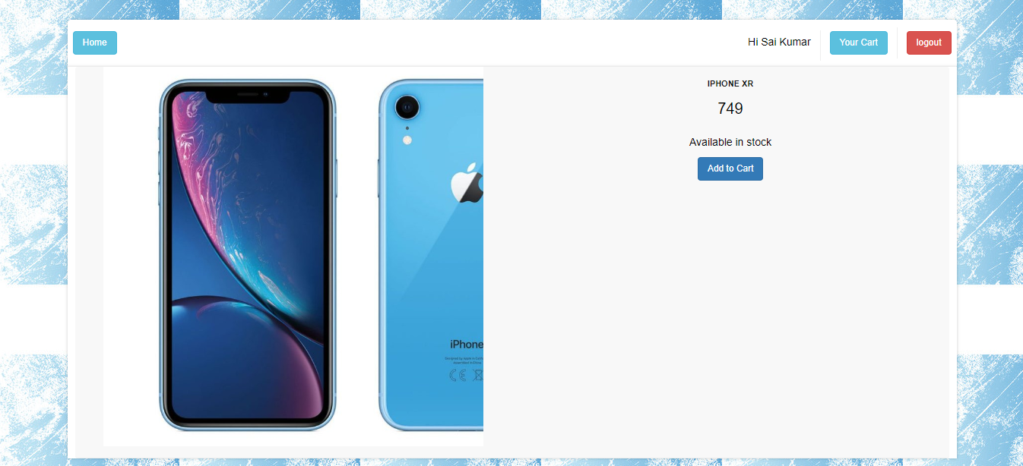
Single Product Page

Slide 14
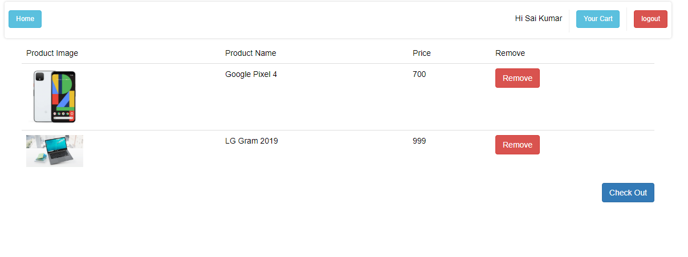
Customer Cart

Slide 15
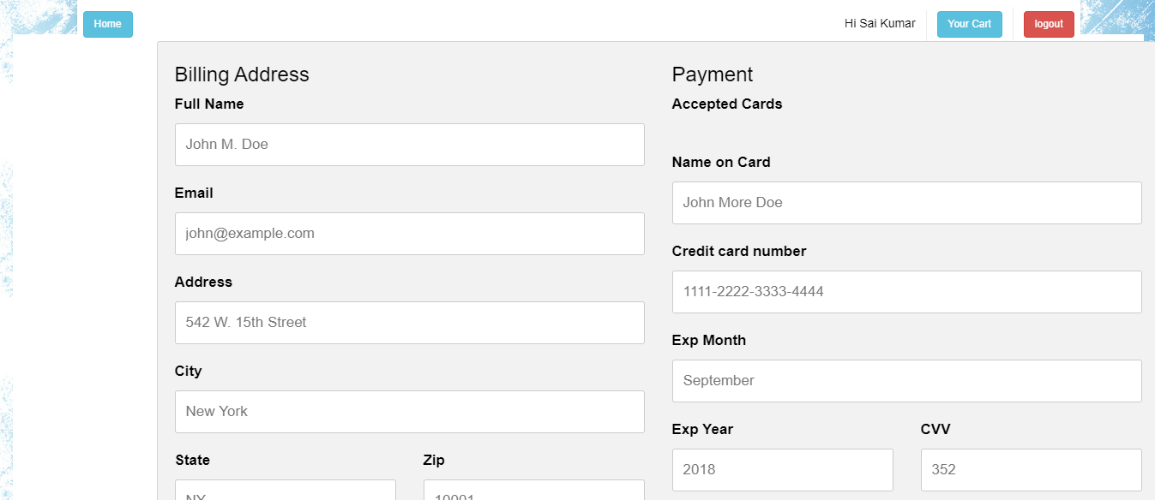

Slide 16
THANK YOU

